Slide 1
Virtual Private Network

Slide 2
Introduction
Networks primarily intended for internal use are called private network.
If we grant access from outside to the private network, the attack surface will significantly broaden.
If the internal resources still use IP address as the basis for authorization, it is not difficult for attackers to access the protected resources

Slide 3
Virtual Private Network
VPN allows users to create a secure, private network over a public network such as the Internet. This is achieved by:
Having a designated host (VPN server) on the network
Outside computers have to go through the VPN server to reach the hosts inside a private network via authentication.
VPN server is exposed to the outside and the internal computers are still protected, via firewalls or reserved IP addresses.

Slide 4
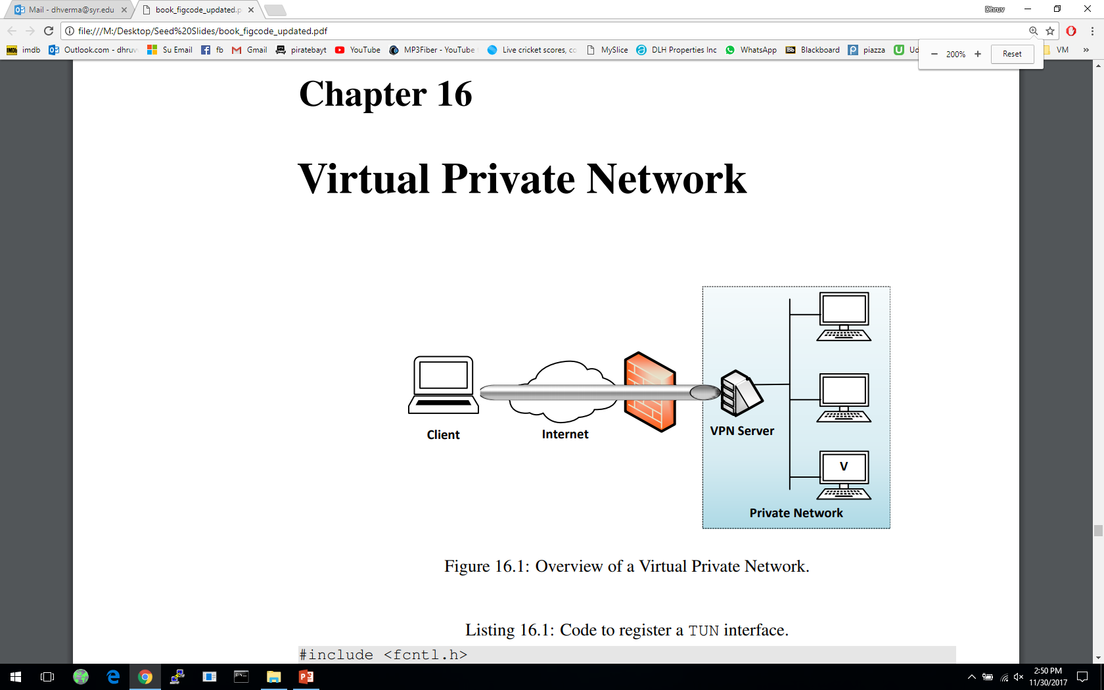
A Typical Setup
This is a typical VPN setup where the “Client” machine wants to connect with machine “V” on a private network. “Client” uses the “VPN Server” to get authenticated to the private network
IP Tunneling

Slide 5



IP Tunneling
Traffics inside the tunnel are protected
Tunnel End A
Tunnel End B
The tunnel goes through a public network, such as the Internet.
The actual packet between the two ends of the tunnel
The payload carries another IP packet, which is the packet that needs to be protected, such as packets to/from a private network

Slide 6
Two Types of IP Tunneling
IPSec Tunneling:
Utilizes the Internet Protocol Security protocol
IPSec has a mode called Tunneling mode, where the original IP packet is encapsulated and placed into a new IP packet
TLS/SSL Tunneling:
Tunneling done outside the kernel, at the application level
Idea is to put each VPN-bound IP packet inside a TCP or UDP packet
The other end of the tunnel will extract the IP packet from the TCP/UDP payload
To secure the packets, both ends will use TLS/SSL protocol on top of TCP/UDP

Slide 7
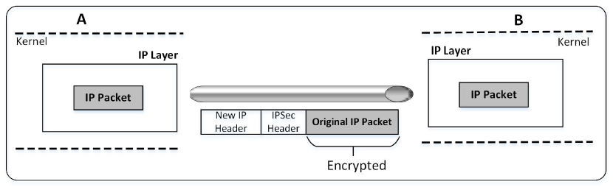
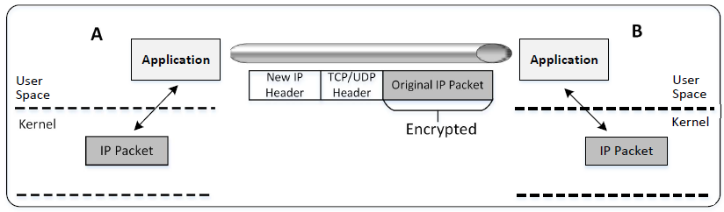
Two Types of IP Tunneling
IPSec Tunneling
TLS/SSL Tunneling
(we will focus on this type)

Slide 8
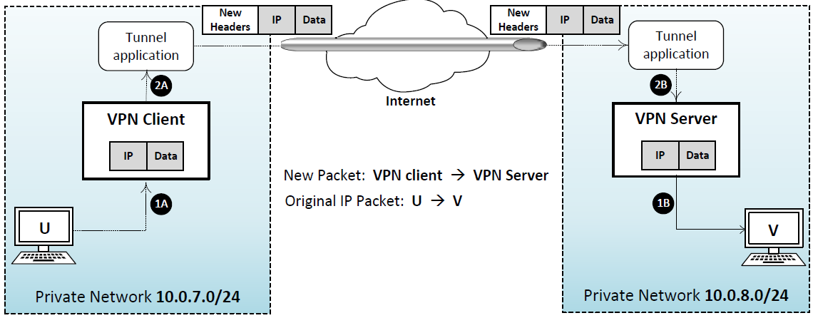
An Overview of How TLS/SSL VPN Works
Question: How can the Tunnel application get an IP packet?
This is just a normal TCP or UDP based SSL connection
Notes:
VPN Client and Server must :
Establish a secure tunnel between them
Forward IP packets that need to go to the other private network
After receiving an IP packet, release it into the private network

Slide 9
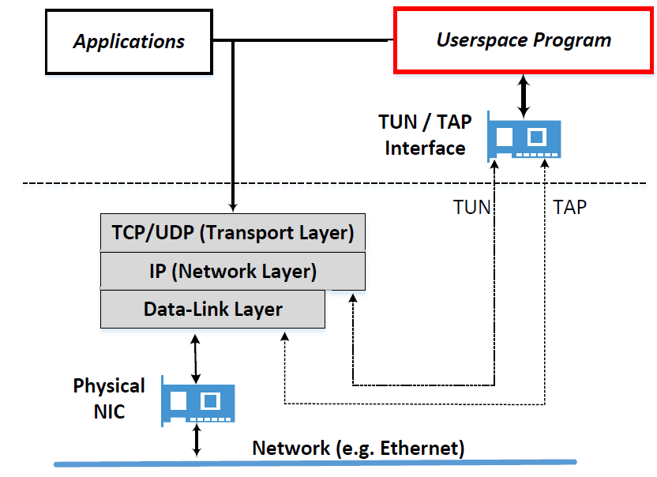
TUN/TAP Interface
Question: How can the Tunnel application get an IP packet?
Typically, applications interact with kernel using socket
Using socket, kernel only gives the data part of a packet to applications
Applications need to use a different way to interact with kernel
Socket Interface

Slide 10
TUN/TAP Interface
Most operating systems have two types of network interfaces:
Physical: Corresponds to the physical Network Interface Card (NIC)
Virtual: It is a virtualized representation of computer network interfaces that may or may not correspond directly to the NIC card. Example: loopback device
TUN Virtual Interface
Work at OSI layer 3 or IP level
Sending any packet to TUN will result in the packet being delivered to user space program
TAP Virtual Interfaces
Work at OSI layer 2 or Ethernet level
Used for providing virtual network adapters for multiple guest machines connecting to a physical device of the host machine
Notes:
The primary task for the tunnel application is to establish a TLS/SSL channel, get IP packets from the system and send them over the channel
Establishing the SSL channel will be talked about in Chapter 19
We will focus on how the tunnel application gets the IP packets from the system
TUN/TAP interfaces can be seen as a point-to-point network device, which connects two computers

Slide 11
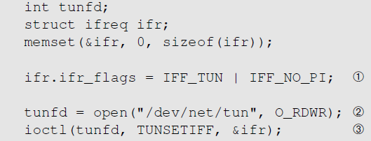
Creating a TUN Interface
The flag IFF_TUN specifies that we are creating a TUN interface
Notes:
A user program can create an TUN/TAP interface and attach itself to the virtual network interface
To the operating system, it appears that the packets come from an external source through the virtual network interface
It is important to note that in Linux, we create network devices, including TUN/TAP devices, a process to be either root or have the CAP_NET_ADMIN capability

Slide 12
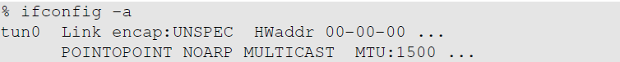
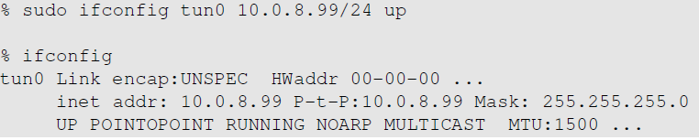
Configure the TUN Interface
Find the TUN interface
Assign an IP address to the TUN interface and bring it up

Slide 13
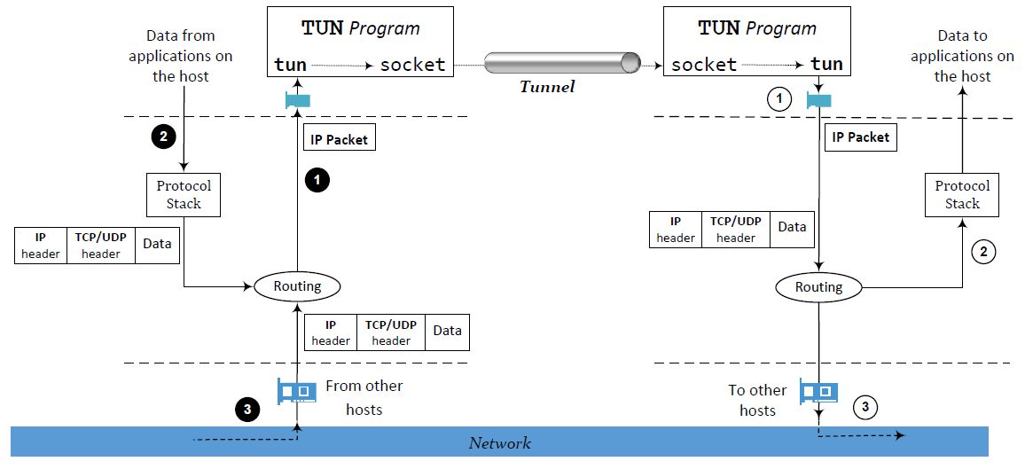
Set UP the Routing
Routing packets to the tunnel

Slide 14
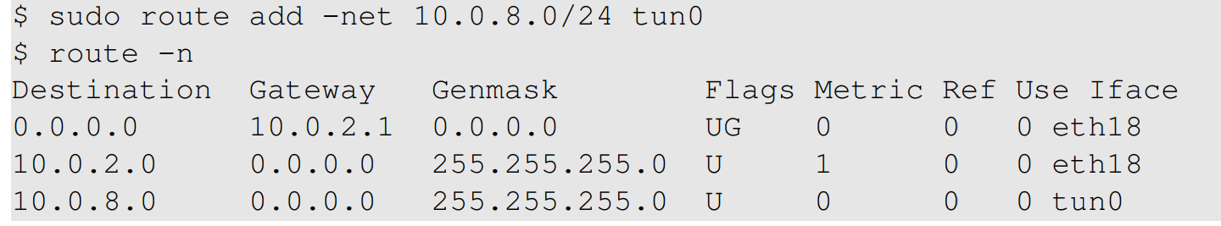
Set UP the Routing
Packets to this destination should be routed to the tun0 interface, i.e., they should go through the tunnel.
All other traffic will be routed to this interface, i.e., they will not go through the tunnel

Slide 15
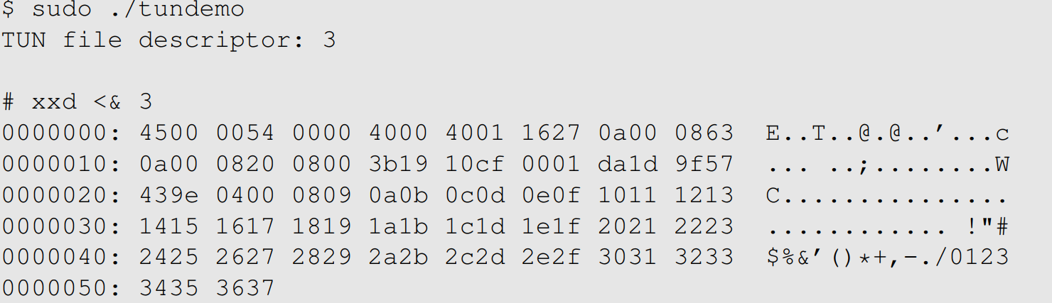
Experiment: Reading From TUN Interface
We did an experiment by sending a ping packet to 10.0.8.32. The packet was sent to the TUN interface and then to our program. We use “xxd” to read from the interface and convert the into hexdump.
0a00 0863: Source IP (128.0.8.99)
IP Header
0a00 0820: Destination IP (128.0.8.32)
Notes:
We can see that the output includes the IP header : 45 is usually the starting octet for most IPv4
It should be noted that “<& 3” in the above command redirects the standard input device to file descriptor 3

Slide 16
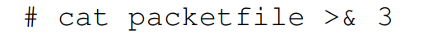
Experiment: Writing To TUN Interface
We can write data to TUN interfaces.
We can create a valid packet using the same “xxd” command.
Copy-paste the xxd output from the previous slide into a file called “hexfile” and run “xxd –r hexfile > packetfile”.
Now we write the packetfile to the interface:
We should be able to observe the packet using Wireshark.
Notes:
It should be noted that “>& 3” in the above command redirects the standard output device to file descriptor 3

Slide 17
Establish a Transport-Layer Tunnel
A tunnel is just a TLS/SSL connection.
Two applications (VPN client and server applications) just establish a TLS/SSL connection between themselves.
Traffics inside are protected by TLS/SSL
What makes this TLS/SSL connection a tunnel?
The payloads inside are IP packets
That is why it is called IP tunnel

Slide 18
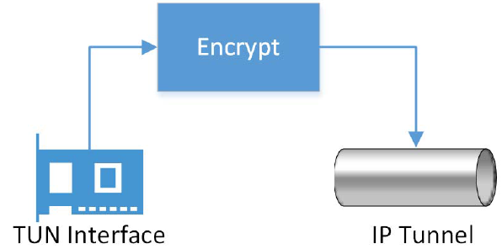
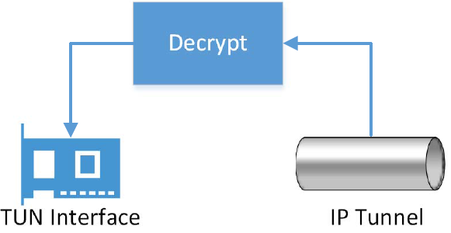
How to Send/Receive Packets via Tunnel
Sending a packet via the tunnel
Get an IP packet from the TUN interface
Encrypt it (also add MAC)
Send it as a payload to the other end of the tunnel
Receiving a packet from the tunnel
Get a payload from the tunnel
Decrypt it and verify its integrity
We get the actual packet
Write the packet to the TUN interface

Slide 19
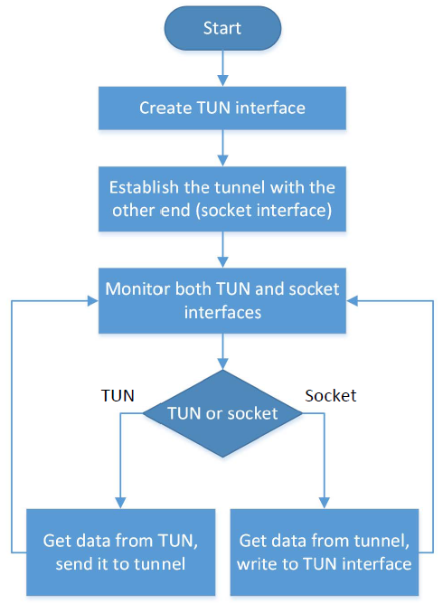
Monitoring Both Interfaces
Each tunnel application has two interfaces: socket and TUN
Need to monitor both
Forward packets between these two interfaces

Slide 20
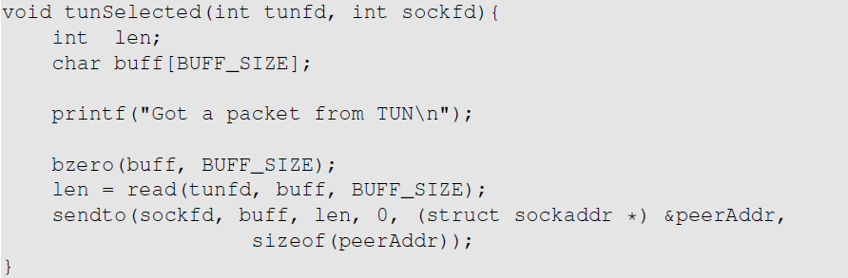
Implementation (TUN → Socket)
Note: the encryption step is omitted from the code (for the sake of simplicity)

Slide 21
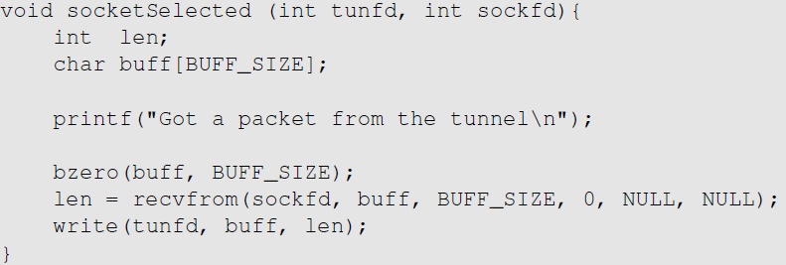
Implementation (Socket → TUN)
Note: the decryption step is omitted from the code (for the sake of simplicity)

Slide 22
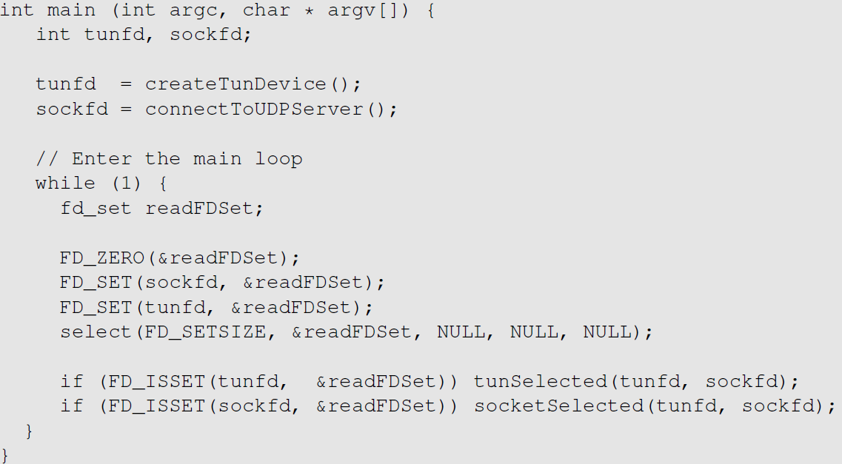
Implementation (Monitoring the 2 Interfaces)
select() will be blocked until one of the interfaces has data.

Slide 23
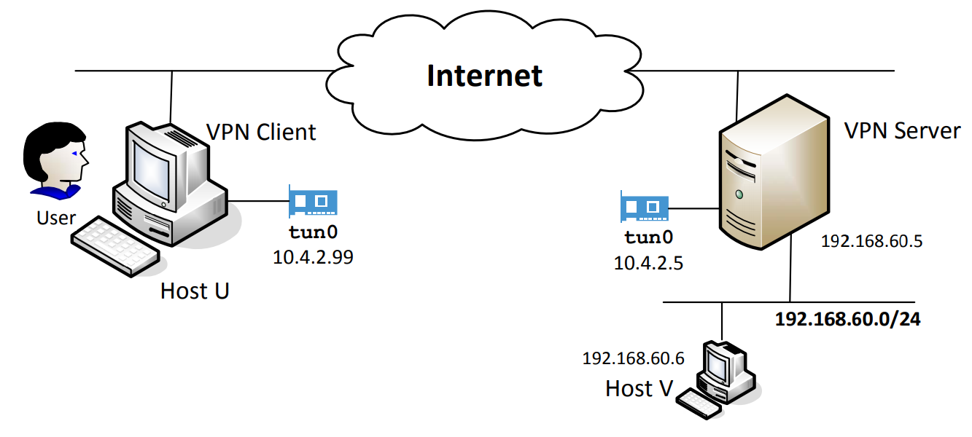
Case Study: Configuring a VPN

Slide 24
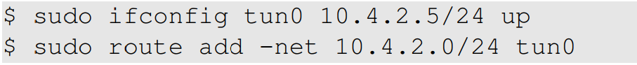
Configure VPN Server
On VPN Server, we first run the server program.
Configure the tun0 interface.
We use 10.4.2.0/24 as IP prefix for the TUN interface (for both VPN Client and VPN Server)
The following two commands assign the IP address to the tun0, bring it up and then add a corresponding route to routing table.

Slide 25
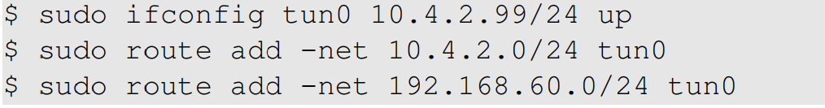
Configure VPN Client
On VPN Client, we first run the client program.
Add route for the 10.4.2.0/24 network.
Add a route, so that all the packets for 192.168.60.0/24 are routed to the tun0 interface.
Notes:
The server program creates a TUN interface (tun0) and waits for a tunnel connection request from a client.
The IP address assigned to the TUN interface on VPN server is 10.4.2.5.
The client program creates a TUN interface (tun0) and sends a “hello” message to VPN Server to establish a VPN tunnel.
The IP address assigned to the TUN interface on the client side is 10.4.2.99.
We also need to tell VPN Client that all the traffic to private network 192.168.60.0/24 should go through the tunnel.
From tun0 interface the packets will be sent through the vpn tunnel.

Slide 26

Configure Host V
The reply packets should go back via the same VPN tunnel, so that they are protected.
To ensure that, route all packets for the 10.4.2.0/24 network toward the tunnel.
For Host V, we route such packets to VPN Server.
Add the following routing entry to Host V:
Notes:
Host V connects to the 10.4.2.0/24 network via the eth1 network interface

Slide 27
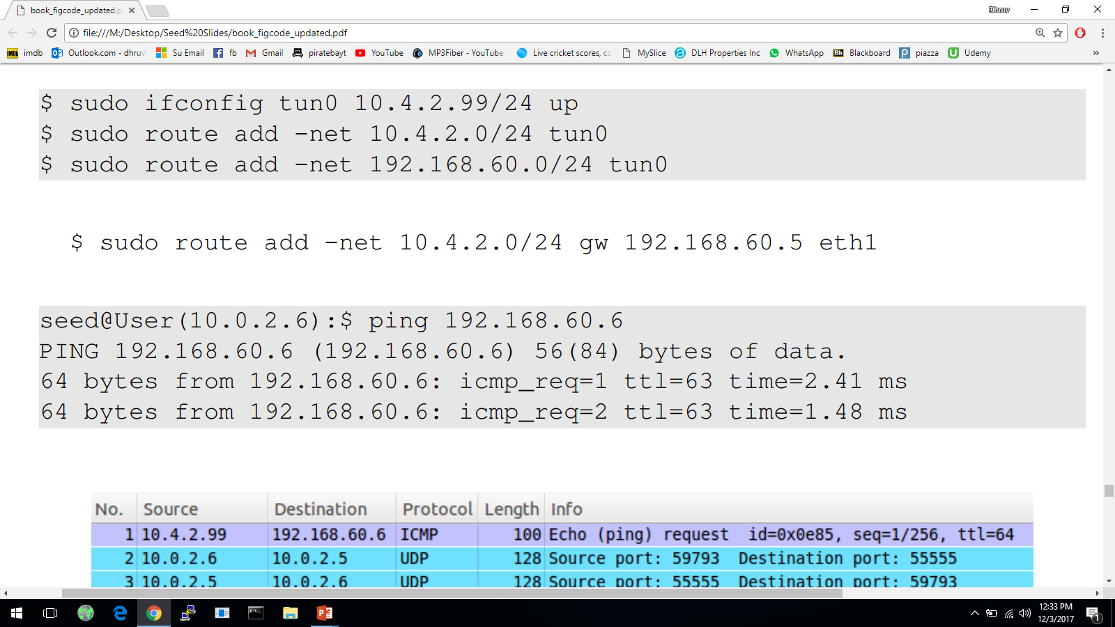
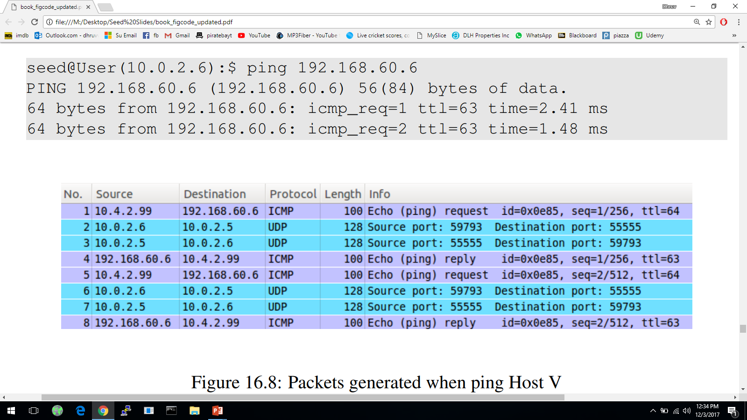
Testing VPN: ping Testing
Ping Host V from Host U and we see the following result:
The following figure shows the packets generated when we ping Host V (192.168.0.6).
Notes:
After the VPN is setup and starts working, Host U can access Host V.
All the network traffic between Host U and Host V will go through a tunnel between VPN Client and VPN Server
To do the ping testing, we ping Host V from Host U.
Before the VPN is established there would be no response from Host V because it is not reachable from Host U
Packet No 1: generated by the ping command. Due to the routing setup, the ICMP packet is routed to the TUN interface (reason why the source IP is 10.4.2.99->assigned to tun0
Packet No 2: the tunnel application gets the ICMP packet, and then feeds it into its tunnel->put it inside a UDP packet towards the VPN Server (10.0.2.5).
Packet No 3: the return UDP packet from VPN Server->inside it is an encapsulated ICMP echo reply packet from 192.168.60.6
Packet No 4: The tunnel application on VPN Client gets this UDP packet, and takes out the encapsulated ICMP packet, and gives it to kernel via the tun0 interface.
Packet No 5 to 8: triggered by another ICMP echo request message.

Slide 28
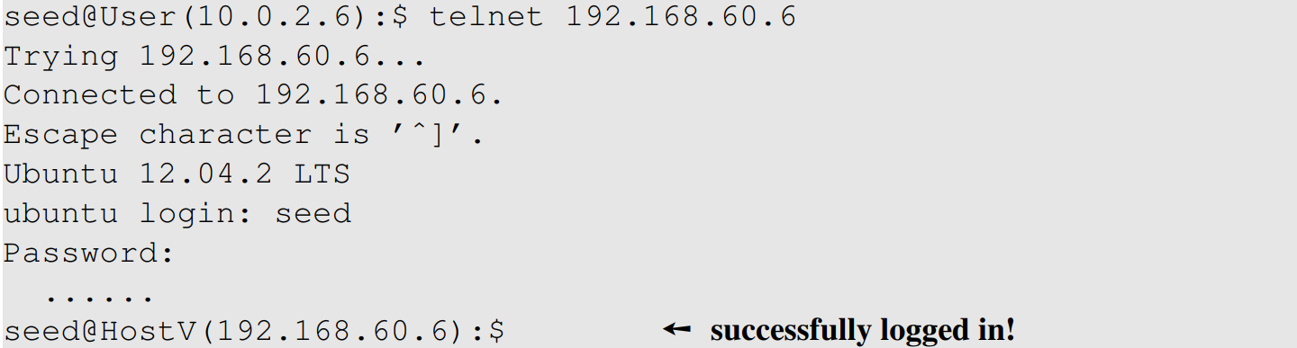
Testing VPN: telnet Testing
The following result shows that we can successfully connect to the telnet server on Host V inside the private network

Slide 29
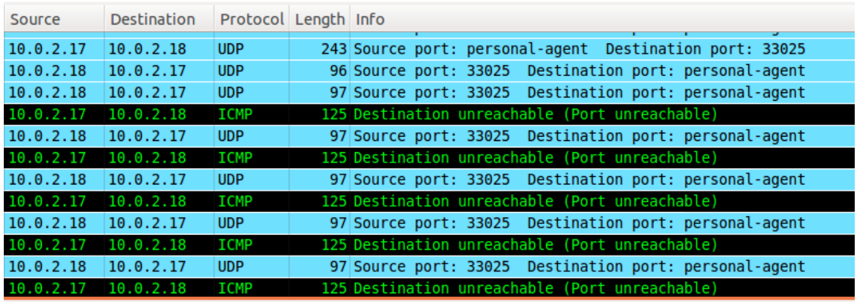
Testing VPN: telnet Testing
Let us break the tunnel and see what happens
Observation: the telnet connection is not broken. TCP will keep resending packets, but they cannot be delivered because the tunnel is broken. Whatever we type in telnet will be buffered by TCP, not lost, but we can’t see anything. As soon as we reconnect the tunnel, everything that we have typed will show up.
Notes:
Telnet is still working but since the packets it sends out via the broken VPN tunnel goes no where, TCP will keep resending the packets.
VPN Server will drop UDP packets and send back ICMP error messages, telling VPN Client that the port is not reachable. That is why we see multiple ICMP error messages.
Whatever was typed into the telnet are actually not lost, they are buffered, waiting to be sent to the telnet server.
When the server receives a character, it echo's the character back to the telnet client, which will print them to the terminal.
Due to TCP transmission, when we reconnect the VPN tunnel, all the blindly typed characters will show up on the client side.

Slide 30
Bypassing Firewalls using VPN

Slide 31
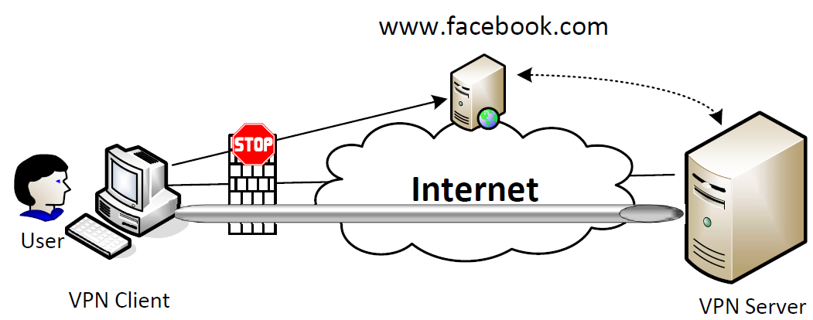
Bypassing Firewall using VPN: the Main Idea
Send our Facebook-bound packets to the TUN interface towards VPN server
VPN server will release our Facebook-bound packets to the Internet
Facebook’s reply packets will be routed to the VPN server (question: why)
VPN server sends the reply packets back to us via the tunnel
Notes:
Question: why would Facebook reply packets be routed to the VPN server, not directly to User?
Answer: The source IP address on the TUN interface (on the VPN client) belongs to the VPN server’s network.
This IP address is the source IP address of the packet from User to Facebook. That is why the reply packets will be routed to the VPN server’s network, which will
further route the packet to VPN server.

Slide 32
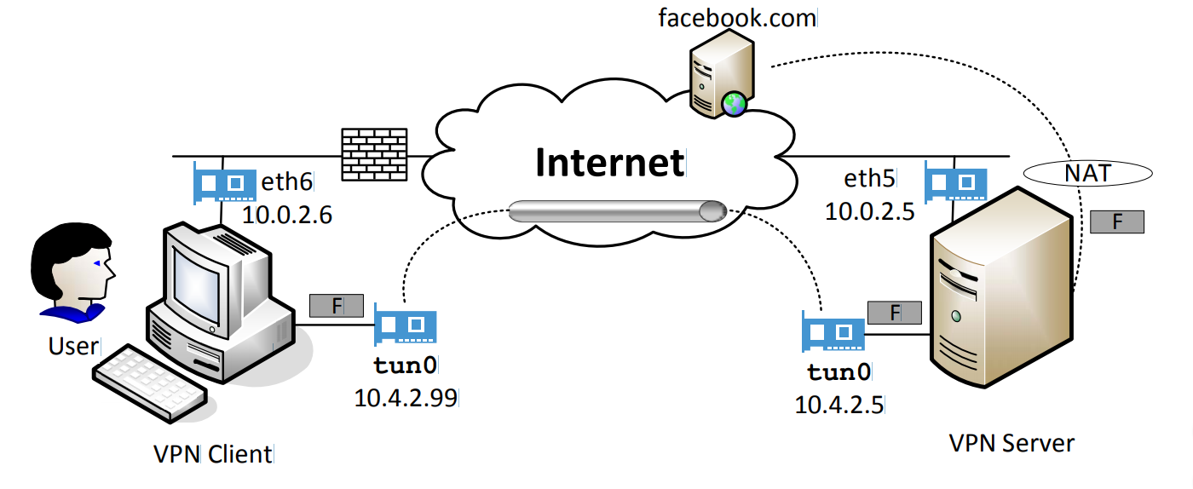
Experiment: Network Setup

Slide 33
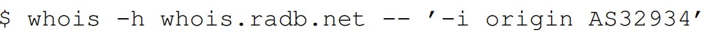
Setting UP Firewall
Setup firewall to block User from accessing Facebook
We run the following command to get the list of IP prefixes owned by Facebook:
We can also get IP addresses returned by Facebook’s DNS server by running the following command (this IP address can change): dig www.facebook.com
Notes:
VPN was developed for security purpose, but now used to defeat another security solution -> bypassing firewall.
Organizations or countries conduct egress filtering on their firewall to prevent their internal users from accessing certain websites.
These firewalls inspect the destination address of each outgoing packet; if the address is on their blacklist, the packet will be dropped.
VPN becomes natural solution for this purpose because it can hide a disallowed packet inside a packet that is allowed.
The actual packet becomes the encrypted payload inside the allowed packet.

Slide 34
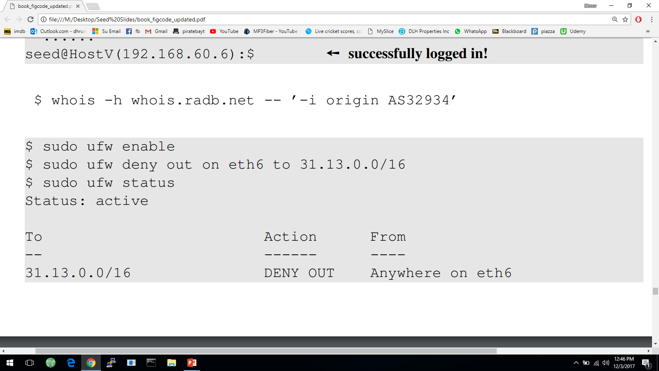
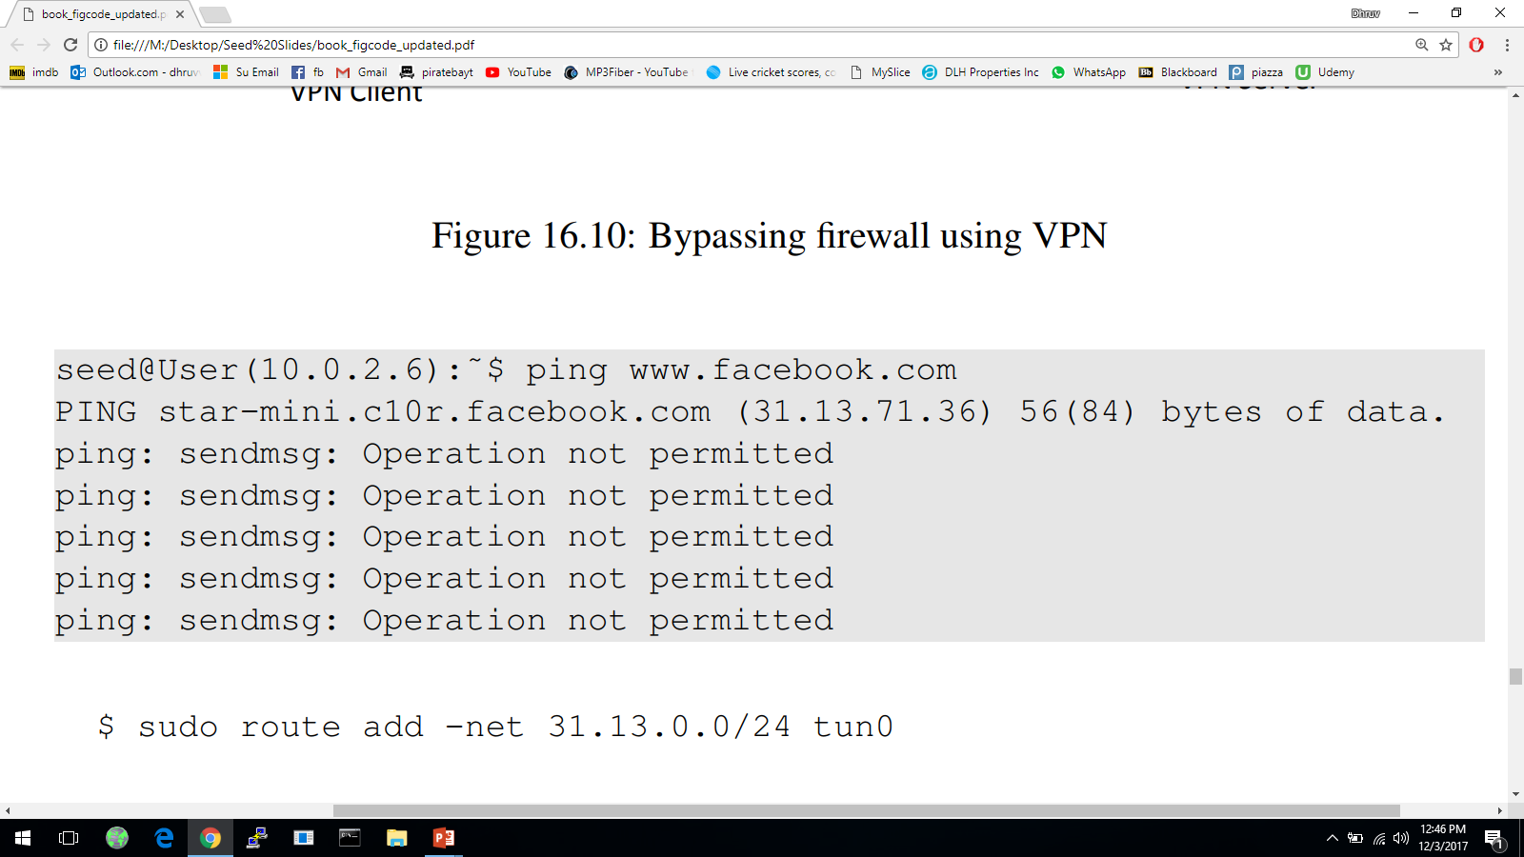
Blocking Facebook
One of the IP prefixes belong to Facebook
Facebook becomes unreachable

Slide 35
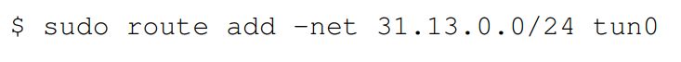
Bypassing the Firewall
We add a routing entry to the user machine, changing the route for all Facebook traffic. Instead of going through eth6, we use the TUN interface:
The Facebook-bound packets are going through our tunnel.
The Facebook-bound packets are hidden inside a packet going to the VPN server, so it does not get blocked.
VPN server will release the packet to the Internet.
Replies from Facebook will come back to VPN server, which will forward it back to us via the tunnel.

Slide 36
Summary
What is VPN?
IP tunneling
IP tunneling using TLS/SSL
TUN/TAP interface
Building a VPN using TUN/TAP interface
Using VPN to bypass firewalls

